Slide 1
Name and Address Parsing
Project Team

Slide 2
Name and Address Parser Approach
The Name and Address Parser is designed in order that the user can be easily able to segregate the names and addresses with respect to the US Name and Address Format.
It also deals with those kind of addresses that are not in a structured format.

Slide 3
Technologies Used
Python (3.9)
JSON
Currently we are using pure python and interacting with the JSON files for the input and the output as well

Slide 4
Steps in Name and Address Parsing
There are a kind of roughly 2 main steps in Name and Address Parsing
Name and Address Parsing
Exception Handling

Slide 5
Step-1 Name And Address Parsing
This Step is responsible to split the name and addresses, and also generate its Masks
Confused??
Next Slide→

Slide 6
What is a Mask ??
A mask is generally a Combinations of individual tokens which are generated with the help of a Word-Table.
Now a word table is generally a pipe delimited file which has tokens, which contribute in generating the Masks
Lets have an example …

Slide 7
Example
Dr. John Talburt, Jr, IQCP, 123-1/2 N. Oak Street, Apt 3A, Little Rock, ARK 72203-4352
Now suppose this is a string which is a mixture of Name and Address, Now to make it a structured way we perform Cleaning

Slide 8
Cleaning and Tokenizing
Cleaning will remove the extra punctuation except the Comma (as a delimiter preserved) and will compare it with 2 Word table
1. US Address Word Table
2. Name Word Table

Slide 9
Getting the Tokens and Generating the Masks
Now Suppose the Address and Name Was Split and Tokenized as Follows
Pos | Token | Code
1 | DR | P
2 | JOHN | G
3 | TABLURT | L
4 | JR | J
5 | IQCP | Q
Pos | Token | Code
1 | 123-1/2 | N
2 | N | D
3 | OAK | W
4 | STREET | F
5 | APT | S
6 | 3A | N
7 | LITTLE | W
8 | ROCK | W
9 | ARK | T
10 | 72203-4352 | N

Slide 10
Mask
Mask is the combination of the token codes with preserving the commas Like “NDWF,SN,WW,TN” is Address Mask
And “PGL,J,Q” is the Name Mask

Slide 11
Now Comes the final Sub Step (Dictionaries)
Now Dictionaries are a key value pair of Mask as the key and Dictionary as the Value, for an instance
“NDWF,SN,WW,TN” { @USAD_SNO(1)|@USAD_SPR(2)|@USAD_SNM(3)|
@USAD_SFX(4)|@USAD_ANM(5)|@USAD_ANO(6)|
@USAD_CTY(7, 8)|@USAD_STA(9)|@USAD_ZIP(10) }

Slide 12
Step-1 (Final)
Now Suppose we get both the masks of name and address, then we submit then we enter the Buckets of the dictionary accordingly with the indexes given Like
USAD_SNO:[1], means that USAD_SNO’s token is 1 and the first token will go in this bucket (Same for name)

Slide 13
Step 2
Step 2 is very simple in which the Rejected masks with the tokens are then made into the Mask and Dictionaries by the User
Wherein with his knowledge he will enter the buckets corresponding to the addresses
Note:- In the future the machine will replace the Human Involvement Using a Supervised Machine Learning Algorithm

Slide 14
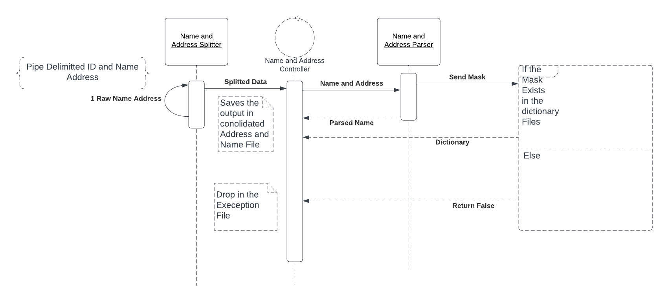
Parsing

